Slide 1
Media Ecologies
Presentation by Bennett Dierckman

Slide 2
Genres of Participation
3 Types of Genres of Participation
Hanging out
Messing around
Geeking out

Slide 3
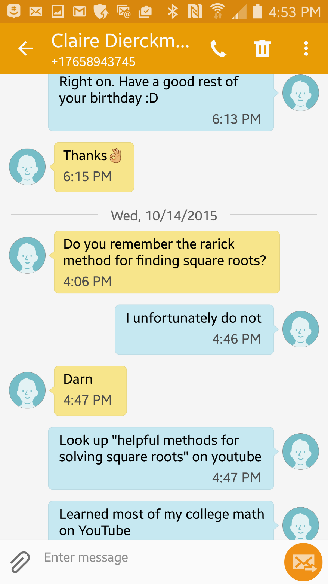

Slide 4

Messing Around
Describes a more intense level of participation with media, involving looking around for and experimenting with new medias and technologies.
Facilitated by media-production
tools and todays technologies.
Driven by interests and motivations.
Gaming is built on this concept.

Slide 5
Geeking Out
Most intense level of engagement.
Made possible by todays media environment.
Access to a community of expertise.
In terms of MMORPG’s geeking out occours when participation extends to paratexts outside of the game.
- http://www.destinyteamfinder.com/xbox360-lfg/
https://fahlo.me/howfahloworks/

Slide 6


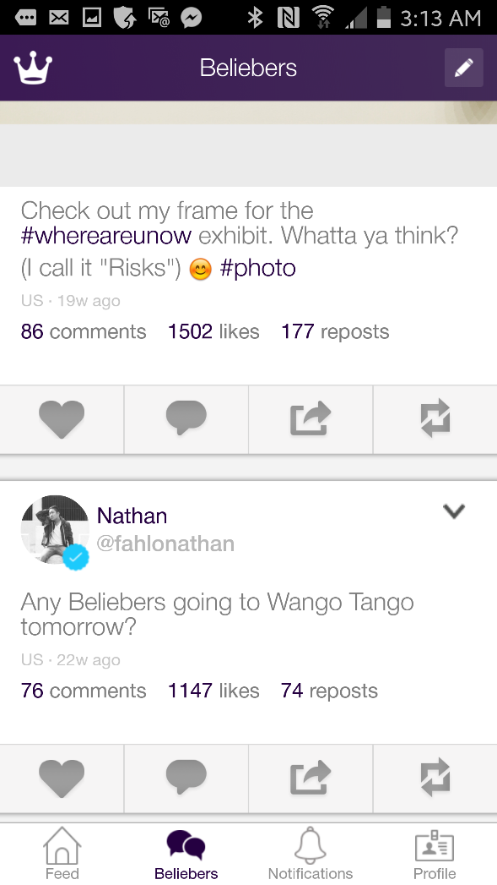
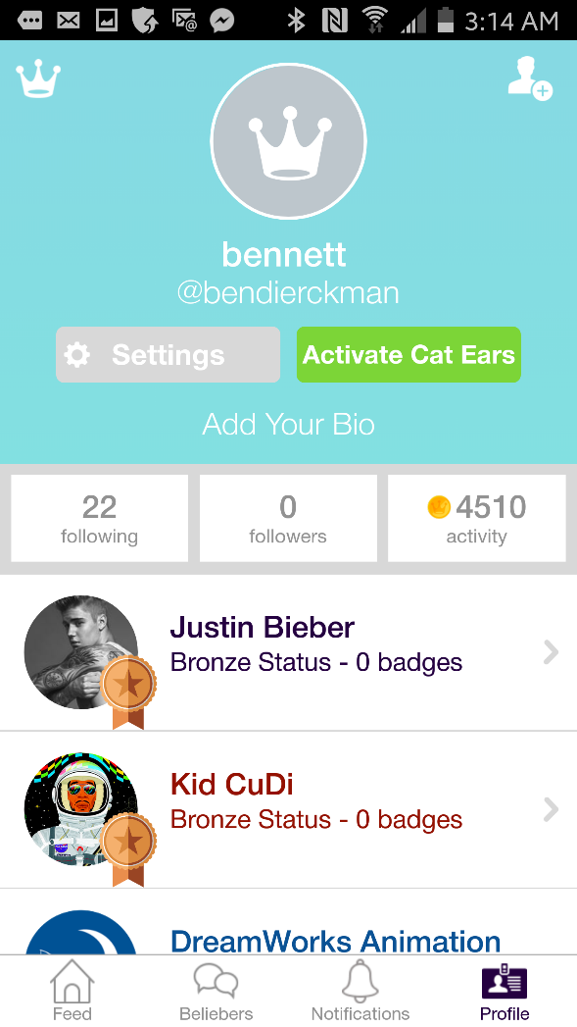
FAHLO

